Slide 1

New Principals/Deans
Jessica Medulla, Special Education Operations Director
Angela Flora, Special Education Programming Director

Slide 2
Learning Intentions
We will review reports for special education and understand how they impact programming decisions
We will review specialized curriculum for special education
We will review Top 5 areas that impact special education

Slide 3

Notes:
Would you rather team up with Wonder Woman or Captain Marvel?
Would you rather lounge by the pool or on the beach?
Would you rather go on a cruise to Alaska or a cruise to the Bahamas?
Would you rather watch nothing but Hallmark Christmas movies or nothing but horror movies?
Would you rather buy 10 things you don't need every time you go shopping or always forget the one thing that you need when you go to the store?
Would you rather spend a week in the forest or a night in a real haunted house?
Would you rather be forced to sing along or dance to every single song you hear?

Slide 4
Using systems to leverage resources
EdPlan
Eligibility
IEP
Infinite Campus
Programming
State reports
BIG report
IEP compliance
Suspensions

Slide 5
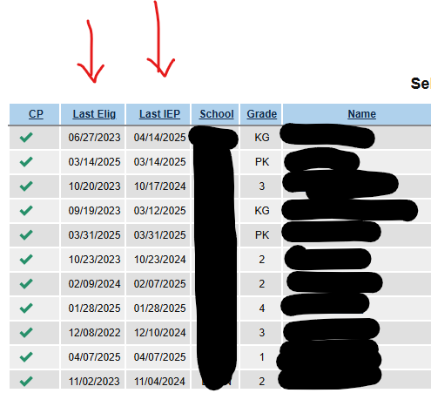
Edplan
Dates are deceiving here.... always check IC too

Slide 6
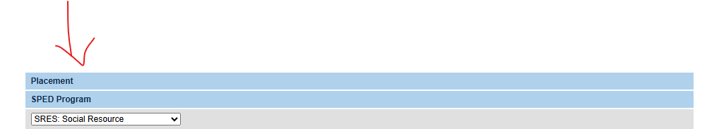
Edplan
Programming Allocations are created in EdPlan first and sync to IC

Slide 7
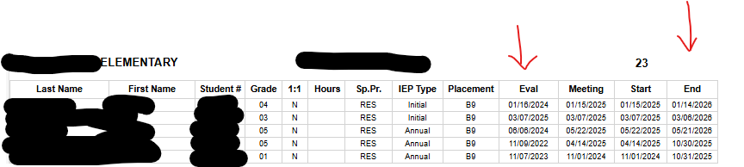
Infinite Campus

Slide 8
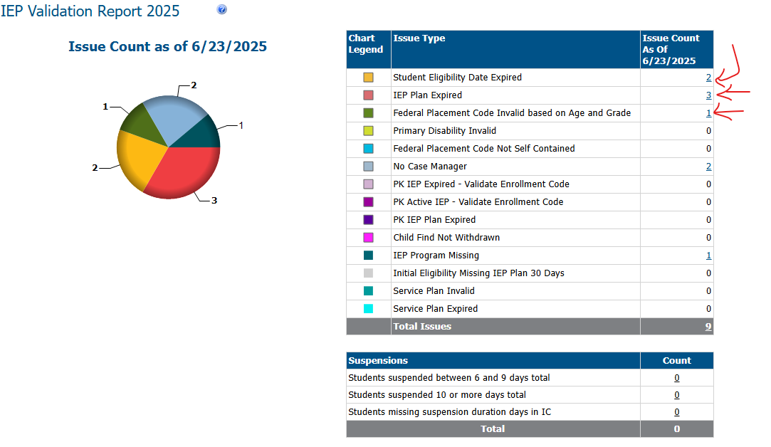
BIG Report

Slide 9
WCSD Specialized Programs
Program descriptions

Slide 10
Why This Matters for Administrators
Understand the specialized programs used in classrooms.
Recognize how curricula connect to IEPs.
Know what to look for during observations, coaching, or compliance checks.
Support teachers in selecting appropriate materials for student needs.

Slide 11
Specially Designed Instruction
Specialized or intensive curricula and instructional strategies
Above and beyond what is offered through the Tiered Systems of Support
Several programs that have been purchased for teachers for use with students with IEPs

Slide 12
Today’s Curriculum Stations
SMARTS (Executive Functioning)
STAR (Autism Programming)
Unique/N2Y (Adapted Curriculum)
Wilson Reading (Structured Literacy)
Lindamood Bell (Multisensory Reading & Language)
Zones of Regulation (Social Emotional Learning)
Visual Supports (Environmental Supports)
Transition Services (Post-Secondary Planning)

Slide 13
How Curriculum Aligns to IEPs
Specialized curricula often reflected in Present Levels and SDI.
Program selection is based on identified student needs.
Expect to see research-based methodologies noted.
Curriculum drives goals, instruction, and service delivery.

Slide 14
Station Rotations
Spend 5-7 minutes at each station.
Use your notetaker to capture key information.
Ask questions to clarify how the curriculum is used.
This resource is for your reference as you support your teams!

Slide 15
Unique Learning System
Grade Bands-Elementary K-2 and/or Intermediate 3-5)
  Comprehensive ELA and Math curriculum aligned to connector standards
  Benchmark assessments and pre/post unit assessments
  News 2 You- supplemental daily news article with visual support
ULS overview

Slide 16
STAR Autism Support
STAR Kits (Strategies for Teaching Based on Autism Research), Levels 1-3 available
  Discrete Trial (DT), Pivotal Response Training (PRT), and Functional Routine (FR) lessons that target Receptive Language, Expressive Language, Functional Routines, Preacademic Concepts, and Play and Social Interactions.
  Comprehensive data collection
STAR overview

Slide 17
SMARTS
Purpose:
  Supports students with executive functioning deficits.
  Direct, explicit instruction to build organization, planning, working memory, self-monitoring, and problem-solving skills.
Who It Serves:
  Students in SIP classrooms; also adaptable for other students needing EF support.
Key Features:
  Structured lessons targeting EF skills.
  Student self-reflection and goal setting.
  Embedded coaching for skill generalization across environments.
Connection to IEPs:
  May appear as: "direct instruction in executive functioning skills," or "explicit instruction in organizational strategies."
Your Role as Leader:
  Look for direct instruction of EF skills during observations.
  Ensure fidelity to the SMARTS curriculum sequence.

Slide 18
Wilson Reading System
Wilson Reading System Overview
Purpose:
  An intensive, research-based, structured literacy intervention designed for students with significant reading and spelling challenges, including dyslexia.
Key Features:
  Based on Orton-Gillingham principles
  Explicit, systematic, cumulative instruction
  Focus on phonemic awareness, decoding, encoding, fluency, vocabulary, and comprehension
  Delivered in small groups or 1:1 settings
  Uses multisensory techniques: tapping, word cards, magnetic tiles, controlled text
Who It Serves:
  Students (grades 2–adult) who struggle with word-level reading
Supporting Research:
  Recognized as evidence-based by Institute of Education Sciences (WWC)
  Demonstrated effectiveness for students with dyslexia and severe decoding deficits

Slide 19
Lindamood Bell
Purpose:
  Evidence‑based, sensory‑cognitive reading intervention designed for students (K–adult) with decoding, comprehension, language processing, and learning difficulties such as dyslexia, ADHD, and auditory processing issues
Core Programs & Focus Areas:
  LiPS® (Phoneme Sequencing): Builds oral‑motor awareness of phonemes for strong decoding and spelling
  Seeing Stars® (Symbol Imagery): Develops mental imagery of letters/words for accurate and fluent reading
  Visualizing & Verbalizing®: Enhances concept imagery to boost comprehension, critical thinking, and memory
Instruction & Delivery:
  Typically individual or small‑group (2–5) sessions
Multisensory, explicit, systematic
  Curriculum tailored via ongoing assessment and progress monitoring

Slide 20
Zones of Regulation
Purpose:
  A structured social–emotional learning framework teaching self-regulation and emotional control through a common, non-judgmental language of four color-coded “Zones”
The Four Zones:
  Blue Zone = low state (sad, tired, bored, sick)
  Green Zone = calm, focused, optimal for learning
  Yellow Zone = heightened alertness (anxious, excited, frustrated)
  Red Zone = extreme emotional states (anger, panic, out of control)
How It Works:
  Teaches emotion awareness, triggers, expected behaviors
  Builds a toolbox of specific regulation strategies (sensory tools, cognitive techniques, breathing)
  Empowers learners to recognize and move between zones to meet situational demands
Implementation:
  Delivered via a digital or print curriculum with visuals, lessons, check‑ins, strategy cards

Slide 21
Visual Supports
Purpose:
  Concrete, consistent visuals help all students understand expectations, routines, and learning tasks.
Types of Visual Supports:
  Schedules & routines
  Behavior charts & social stories
  Graphic organizers & anchor charts
  Choice boards & communication supports
Benefits:
  Reduce anxiety, increase predictability
  Support executive functioning
  Build independence and self-regulation
  Scaffold academic and language learning
Best Practices:
  Use schoolwide visual systems
  Teach students how to use supports
  Embed into instruction, behavior, and routines
Evidence-Based:
  Grounded in UDL
  Effective across disabilities and learning profiles

Slide 22
MS and HS-Transition Services
Purpose:
  Prepare students with disabilities for life after high school — including education, employment, and independent living.
Key Components:
  Student-Centered Planning: Interests, strengths, preferences drive goals
  Transition Assessments: Identify skills, needs, and services
  IEP Transition Goals: Aligned to postsecondary outcomes
  Instruction & Services: Life skills, vocational training, self-advocacy, job exploration
  Agency Collaboration: Vocational Rehab, community services, college supports
When It Starts:
  No later than age 14 (middle school) in most states
  Continues through high school and into 18-22 programs as needed
Benefits:
  Increases student engagement and ownership
  Builds real-world readiness
  Promotes successful post-school outcomes
Key Message for Leaders:
Transition is not a program—it’s an embedded process across instruction, IEPs, and school-community partnerships.

Slide 23


Slide 24
There is a tight timeline for reporting a physical or mechanical restraint
Fact or Fiction

Slide 25

Restraints and Aversive Violations

Slide 26
Districts must provide educational services to students after 10 suspension days
Fact or Fiction

Slide 27

Suspensions

Slide 28
Districts must locate and evaluate all students suspected of having a disability
Fact or Fiction

Slide 29

Child Find

Slide 30
Services in the IEP matter, not the use of a specific methodology
Fact or Fiction

Slide 31

Research based resources

Slide 32
Documentation of IEP Implementation is only required for goals and objectives
Fact or Fiction

Slide 33

IEP Implementation

Slide 34
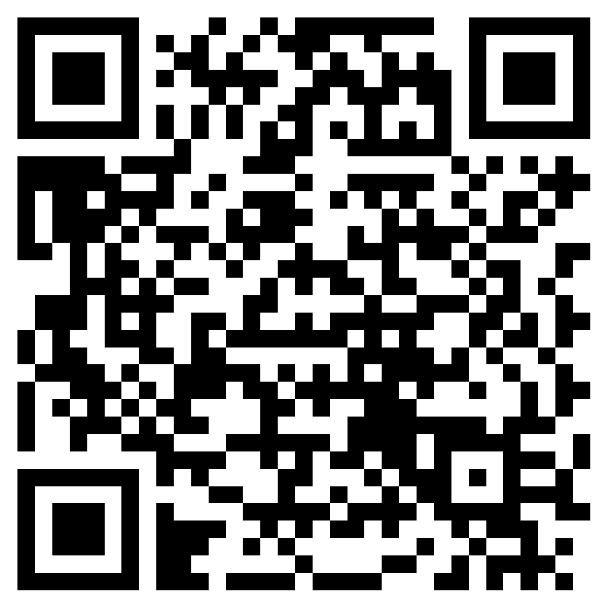
Questions?

